Slide 1
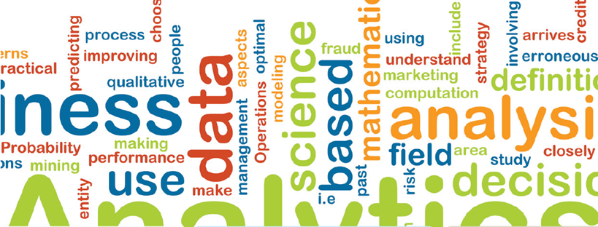
Data Science Laboratory
Ayse Basar Bener
Data Science Lab
Mechanical and Industrial Engineering
Ryerson University

Slide 2
Who are we?
http://www.ryerson.ca/~abener/dsl.html
http://www.datasciencelab.ca
Affiliated faculty members
Ali Miri, CS
Ozgur Turetken, TRSM
Pawel Pralat, Math
Ebrahim Bagheri, EE
Andriy Miranskyy, CS
Ceni Babaoglu, MIE
Post Doc
Bora Caglayan
Shariyar Murtaza
Carl Barrelet
Zeinab Noorian
Tamer Abdou
Atakan Erdem

Slide 3
Who are we?
PhD students
Sedef Akinli Kocak
Parisa Lak
Behjat Soltanifar
Shirin Akbarinasaj
Vijay (Jan)

Slide 4
Who are we?
MSc students
Mefta Sadat
Physical space
EPH 2nd floor- EPH-232

Slide 5
Our Values
We are what we repeatedly do, Excellence, then, is not an act, but a habit. -- Aristotle
From keynote speech, Laurie Williams, Promise 2011

Slide 6
Our Values
Research is about ‘to make a difference’ – impact others
Other researchers
Industry
Mentees
Communication
Research results
Personal interactions/ collaborations

Slide 7
Our Values
Passionately committed
Self confident for hard work
Confidence in your supervisor
Confidence in your program
Should handle criticism positively
Be creative
‘research is fun’

Slide 8
Good Research
Robust methodology
Clear aim, objectives, research methodology
Good data collection and analysis methods
Comprehensive literature review, critical analysis
Well presented, interesting findings
Strong validation
Work already published before you finish thesis
Original findings
Contributions to knowledge

Slide 9
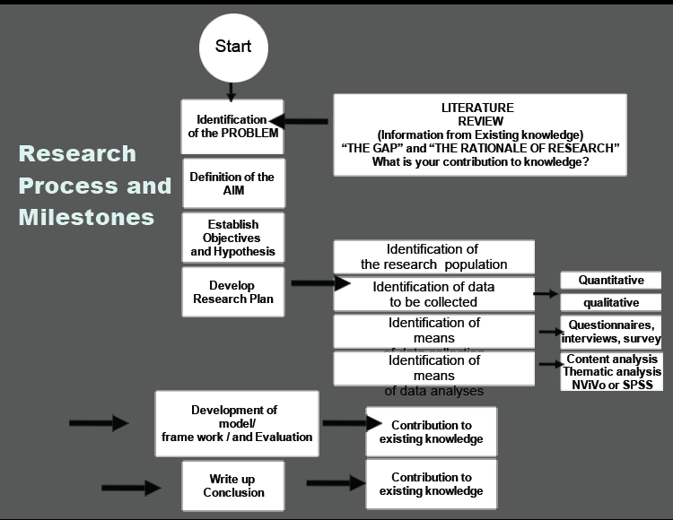

Slide 10
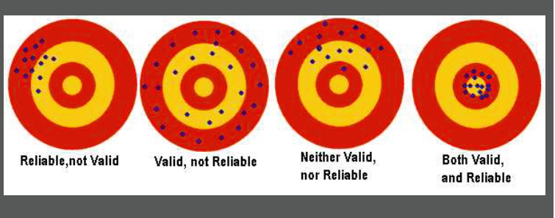

Slide 11
DO
Define a plan of action from Day 1
Find a topic that will interest you
Work with your fellow graduate students
Work closely with your supervisor to get support
Undertake a thorough critical review of the litarature
Present papers in critical conferences and write papers to journals to get feedback from external reviewers and to perfect writing
Write and keep on writing, it cements your thoughts
Take ownership of your work
Be confident, not arrogant

Slide 12
DON’T
Prolong your research and take long breaks
Depend 100% on your supervisor
Think that the supervisor knows everything
Have poor time management
Lose focus or direction
Plagiarize
Underestimate writing
Ignore the importance of meeting your supervisor
Take criticism negatively

Slide 13
Challenges
Be self motivated, positive attitude
Setting your own deadlines
Being hard on yourself
Continuous discussion with peers and maintaining their interest in your work
Get the supervisor interested in your work
Access to companies and data

Slide 14
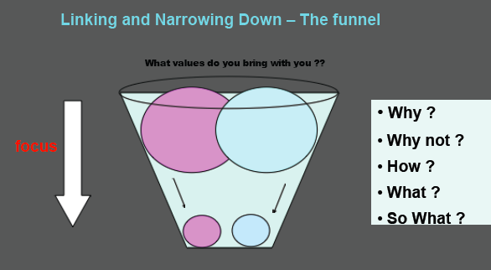
Research requires narrowing down

Slide 15
No silver bullet
Commitment and
Endurance

Slide 16
Supervisor
Must be your best friend
Your success is her/ his success
Similar to parent/ child relationship
Promotes his/ her academic contacts
Meets frequently

Slide 17
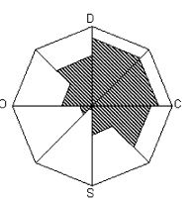
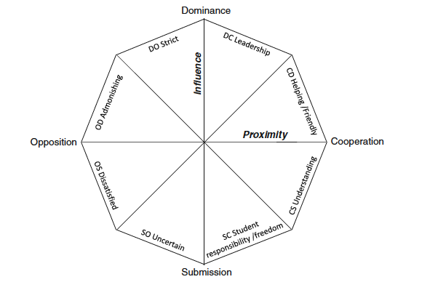
Model for student-supervisor relationship

Slide 18
How do we work?
Weekly DSL seminars
Read, understand, present
Experiment, analyze, present
Discussion and feedback
Research clusters
By topic and by project
Clusters meet weekly
Deadlines
Project
Publication

Slide 19
Why clusters, deadlines, papers, GAships?
Post doc references
Ability to work independently
Ability to collaborate
Ability to work in a multidisciplinary environment
Ability to deliver under pressure
Experience in teaching
Experience in supervising/ mentoring students
Experience in project work

Slide 20
How do we work?
Publications
Conference
Journal
Publishing with
Supervisor
Supervisor and fellow graduate students as appropriate
We DO NOT publish with third parties
Time management
Ethics

Slide 21
How do we work?
Funding
Academic program stipends
Granting agency funding (NSERC, SSHRC)
Ryerson University Research Grant
Industry
GA
Empirical and data driven work
Need data
Tackle industry problems

Slide 22
How do we work?
Job responsibilities
Research
Project
Ga’ship
Formal learning (course work)
Other learning
Seminars
In-house workshops
On-line courses

Slide 23
Our Research
Data science
Decision making under uncertainty
Predictive models/ recommender systems
Analytics
Domains
Energy
Health care (clinical, corporate)
Software engineering
Business Intelligence (finance, consumer products/ services)
Other

Slide 24
Our Research
Theoretical Base
Math (complex networks, graph theory, game theory)
Machine learning
Methodology
Empirical
Data driven
Quantitative and qualitative

Slide 25
Going forward
Projects
Upcoming grant applications
NSERC CRD
MITACS
NSERC Engage
Other
Upcoming conferences and journals

